Slide 1
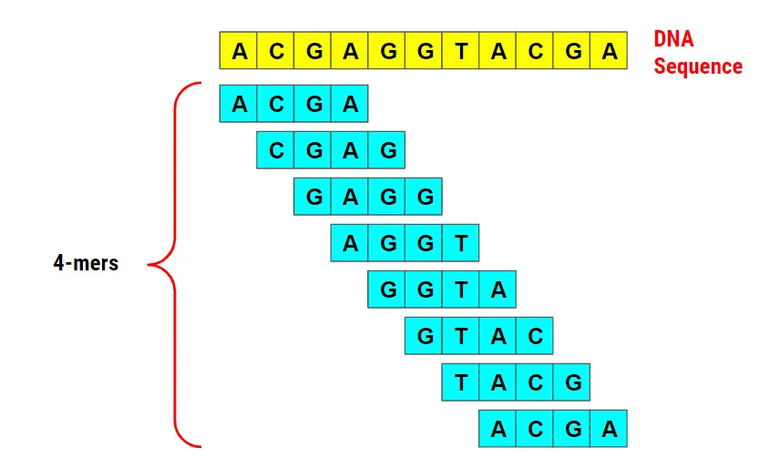
Categorising Bacterial Genera Based on 16S rRNA Sequences Utilizing K-mer Features and XGBoost with the RDP Trainset 18 Dataset
Picture representing th scope of your project
By: Gregory V. Luna
Date: 03/30/2025
CS_697_001_BK_Spring 2025

Slide 2
Outlines
This presentation covers the following: Introduction to 16S rRNA classification; Applications in microbiome research; Literature review on ML and genomics; Key findings from prior studies; Algorithm and approach in 7 steps; Understanding the functions; Obtained results; Conclusion and future work

Slide 3
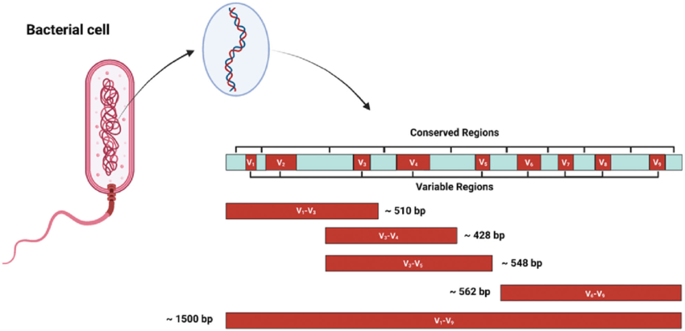
INTRODUCTION
Microbial communities drive ecological and health processes. The 16S rRNA gene is key for bacterial taxonomy [1]. RDP Trainset 18 dataset: 21,195 sequences, 1,735 genera post-filtering. Traditional tools like BLAST struggle with scale [2]. Machine learning offers rapid, alignment-free classification. Goal: Develop a scalable ML classifier for genera using k-mers and XGBoost.

Slide 4
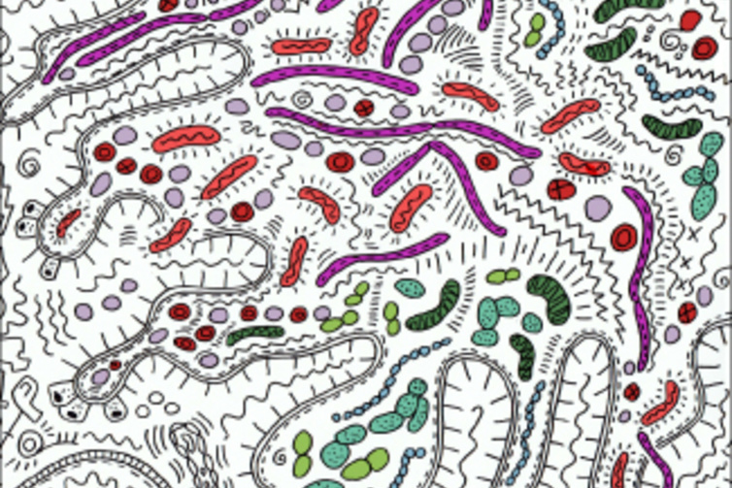
APPLICATION
Accurate genus classification enhances microbiome studies. Enables microbial ecology profiling (e.g., soil, gut). Supports pathogen detection in clinical settings. Aids personalized medicine via microbial signatures. Scalable tools improve high-throughput sequencing analysis. Advances evolutionary biology research.

Slide 5
LITERATURE REVIEW
Woese and Fox (1977) established 16S rRNA as a taxonomic marker [1]. Yang et al. (2020) reviewed ML challenges in DNA mining [2]. Moeckel et al. (2024) highlighted k-mers’ genomic utility [6]. Hamed et al. (2023) achieved 96.3% accuracy with SVM [3]. Caporaso et al. (2010) developed QIIME for 16S analysis [4]. Chen and Guestrin (2016) introduced XGBoost for scalability [9].

Slide 6
LITERATURE REVIEW RESULTS
Traditional methods lack scalability [2]. One-hot encoding loses sequence context [5]. K-mers excel in pattern recognition [6]. SVM achieves high binary accuracy (96.3%) [3]. XGBoost handles multi-class, high-dimensional data [9]. Gaps remain in multi-class 16S rRNA classification.

Slide 7
ALGORITHM/APPROACH
Step 1
Step 2
Step 3
Step 4
Step 5
Step 6
Load 21,195 sequences from RDP Trainset 18.
Filter 1,268 singletons, split 80:20 (15,941 train, 3,986 test).
Extract 250 bp V4 region (400–650 bp).
Test one-hot encoding, shift to k-mers (3–6 bp Top-100, 4–5 bp Full).
Train XGBoost (Top-100: 200 trees, Full: 100 trees).
: Evaluate with accuracy, top-5 accuracy.

Slide 8
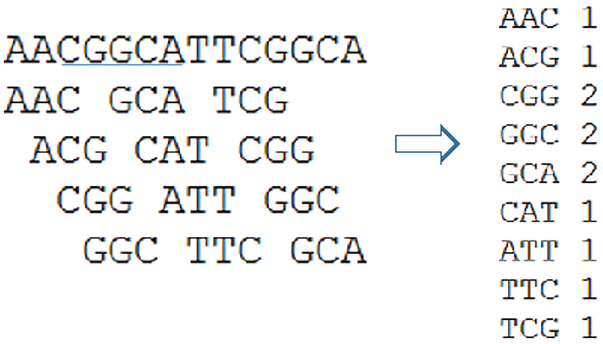
UNDERSTANDING THE FUNCTIONS
K-mers count subsequences (e.g., “ATG”), preserving context [6]. XGBoost builds decision trees, splits on k-mer counts [9]. Gradient boosting minimizes multi-class log loss. Class weights balance rare genera in Full Model. Top-100 uses 3–6 bp k-mers (10,036 features). Full Model uses 4–5 bp k-mers (10,986 features).

Slide 9
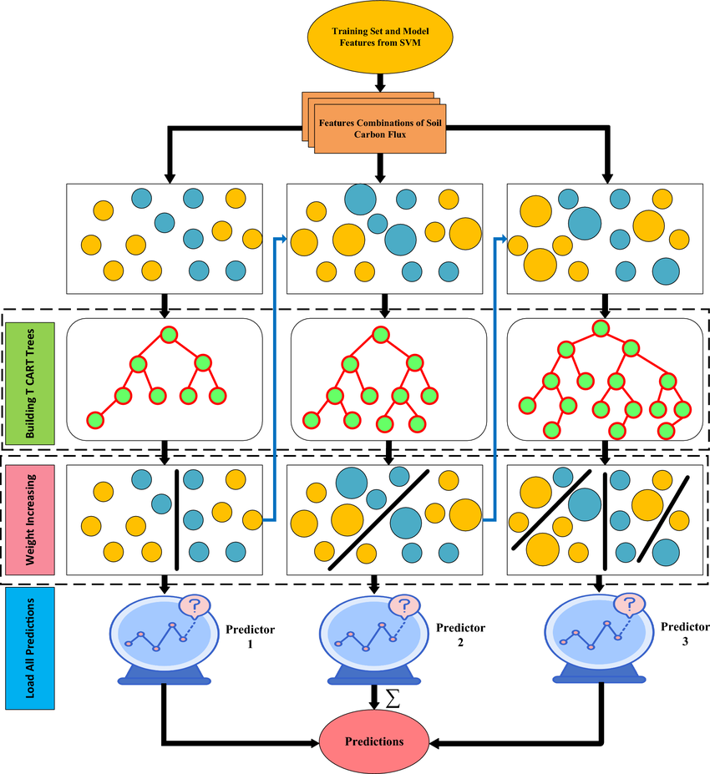
OBTAINED RESULTS
One-hot encoding: RF 0.74%, SVM/CNN 10.83% accuracy [5]. XGBoost Top-100: 97.56% accuracy, 99.79% top-5 (1,908 test samples). XGBoost Full: 82.84% accuracy, 91.57% top-5 (3,940 test samples). 5-fold CV: Top-100 94.48% (±0.58%). Outperforms Hamed et al.’s 96.3% binary [3]. K-mers drive multi-class success.

Slide 10
CONCLUSION & FUTURE WORK
K-mers and XGBoost achieve >97% accuracy in genus classification. Top-100 model excels for efficiency, Full Model scales to 1,712 genera. Future: Test 6–7 bp k-mers, add precision/recall metrics. Map k-mers to taxonomic motifs [7]. Scale to all 1,735 genera. Enhance microbiome research applications.
Conclusion

Slide 11
REFERENCES
[1] C. R. Woese and G. E. Fox, Proc. Nat. Acad. Sci. USA, vol. 74, no. 11, pp. 5088–5090, 1977. [2] A. Yang et al., Front. Bioeng. Biotechnol., vol. 8, p. 1032, 2020.
[3] B. A. Hamed et al., J. Big Data, vol. 10, no. 1, p. 124, 2023. [4] J. G. Caporaso et al., Nat. Methods, vol. 7, no. 5, pp. 335–336, 2010. [5] A. Yang et al., Front. Bioeng. Biotechnol., vol. 8, p. 1032, 2020.
[6] C. Moeckel et al., Comput. Struct. Biotechnol. J., vol. 23, pp. 2289–2303, 2024.
[7] C. R. Woese et al., Proc. Nat. Acad. Sci. USA, vol. 87, no. 12, pp. 4576–4579, 1990. [8] S. D. Jackman et al., Genome Res., vol. 27, no. 5, pp. 768–777, 2017.
[9] T. Chen and C. Guestrin, Proc. 22nd ACM SIGKDD Int. Conf. Knowl. Discov. Data Mining, pp. 785–794, 2016.
[10] R. C. Edgar, Bioinformatics, vol. 34, no. 13, pp. 2247–2249, 2018.

Slide 12
Questions

